Slide 1
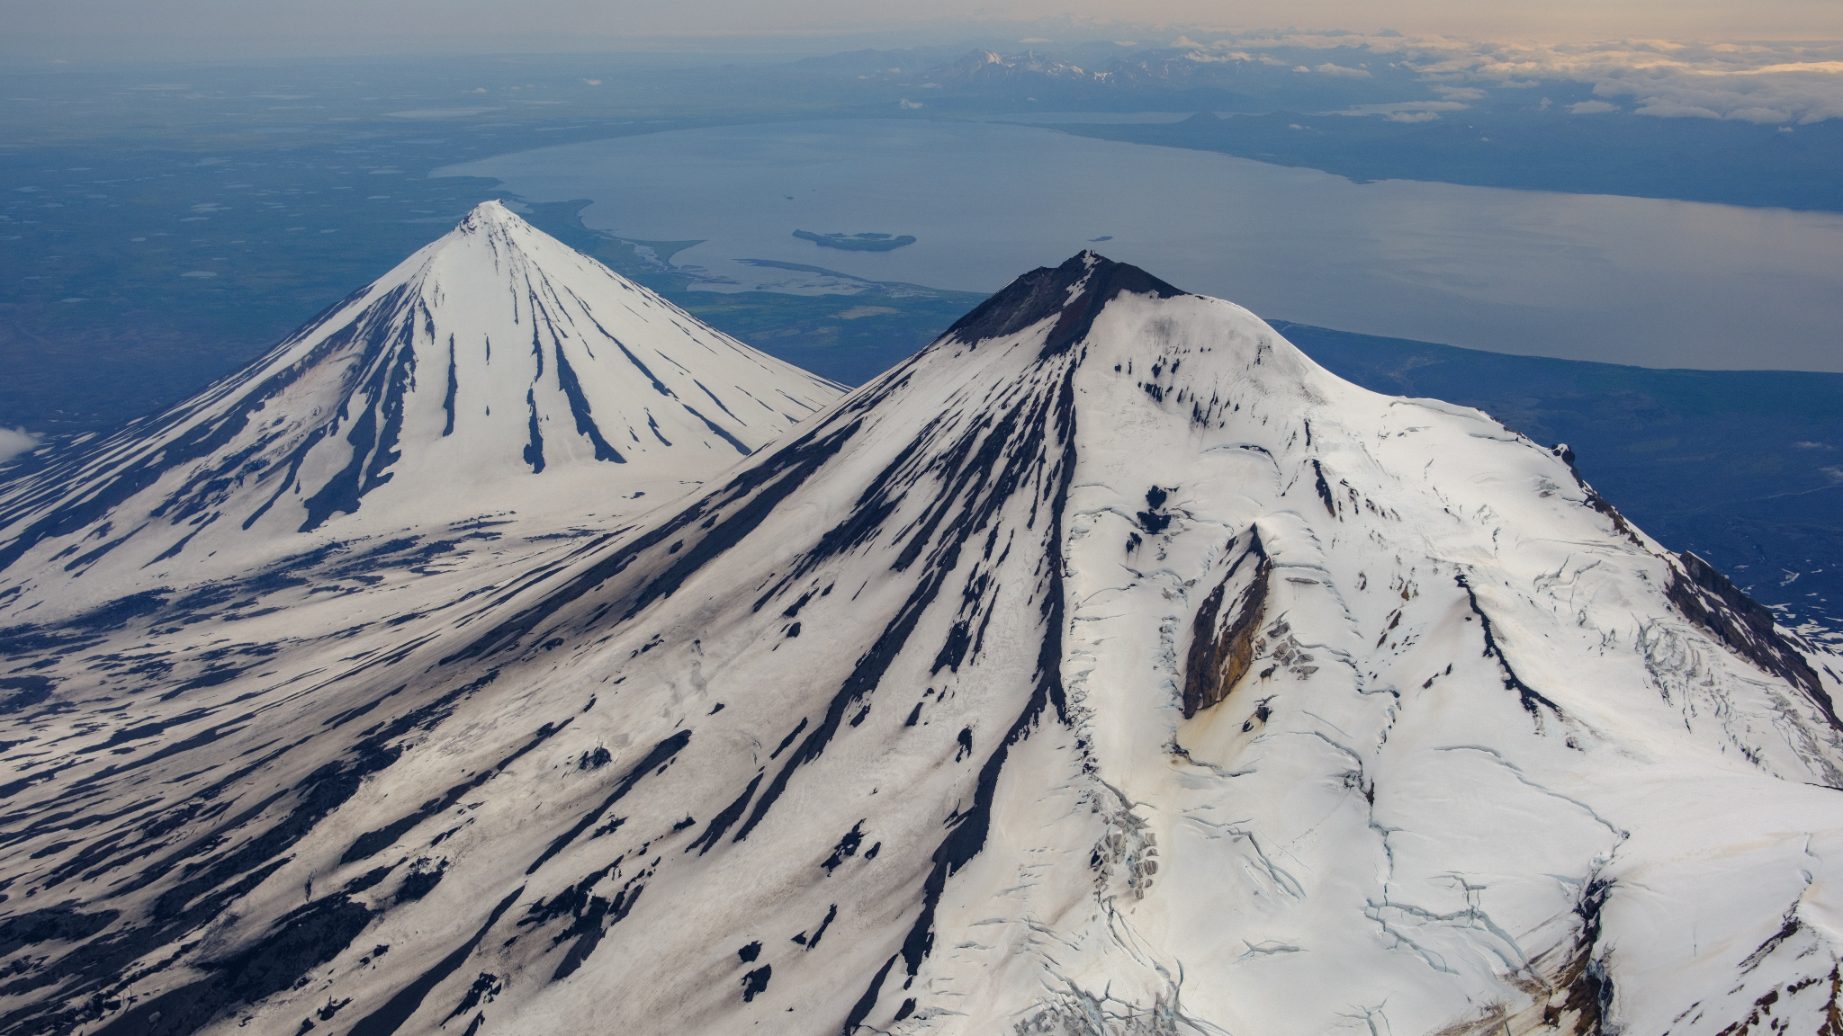



VOISS-Net + TREMCAT: A streamlined approach to
detect, characterize, and catalog volcanic tremor
Darren Tan
Asian School of the Environment, Nanyang Technological University, Singapore
Earthquake Research Institute, University of Tokyo, Japan
Alaska Volcano Observatory, Geophysical Institute, University of Alaska Fairbanks, Fairbanks, AK, USA

Slide 2
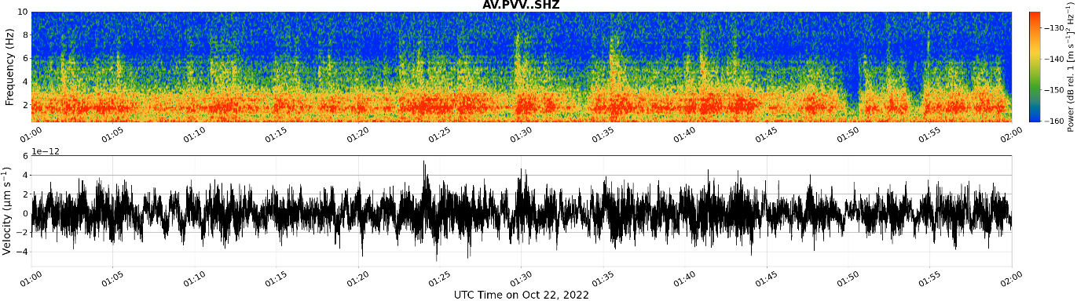
What is volcanic tremor and why bother tracking it?
Volcanic tremor is a semi-continuous seismic and/or acoustic signal that occurs at time scales ranging from seconds to years, with highly variable amplitudes and spectral features.
The phenomena is commonly (and broadly) associated with fluid flux, and is often seen just before, and during volcanic eruptions.
However, many observatories do not have a formalized or systematic way of detecting and cataloging tremor, any many research publications present volcano seismicity without looking or accounting for tremor.
Example of seismic tremor:
1

Slide 3
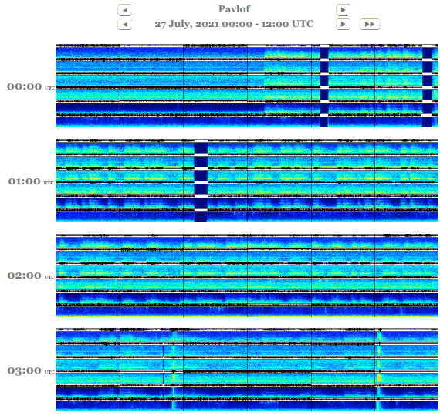
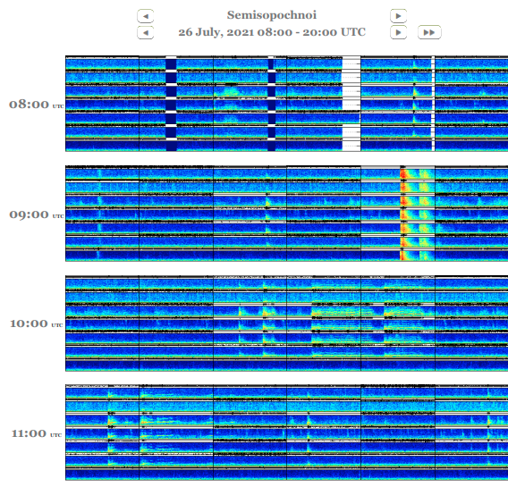
Monitoring tremor is a challenge at observatories
AVO duty seismologists manually scan 24 hours of spectrograms at 30+ volcanoes everyday.
Entering a “tremor entry” is also non-trivial (e.g., how do we pick start and end times and describe tremor?)
2

Slide 4
Towards automated tremor detection and a tremor catalog framework
3

Slide 5

Towards automated tremor detection and a tremor catalog framework
Part 1 – VOISS-Net:
VOlcano Infrasound & Seismic Spectrogram Neural Network
Use machine learning to rapidly detect and characterize of tremor (among other seismic signals).
Offers the ability to scan decades of data for research, and set probability-based alarms in near real-time for monitoring.
3

Slide 6

Towards automated tremor detection and a tremor catalog framework
Part 1 – VOISS-Net:
VOlcano Infrasound & Seismic Spectrogram Neural Network
Use machine learning to rapidly detect and characterize of tremor (among other seismic signals).
Offers the ability to scan decades of data for research, and set probability-based alarms in near real-time for monitoring.
Part 2 – TREMCAT: TREMor CATalog
Provides a structured way to catalog tremor instances,
storing key attributes and multiple location entries.
Facilitates sharing and distribution of tremor catalogs.
3

Slide 7
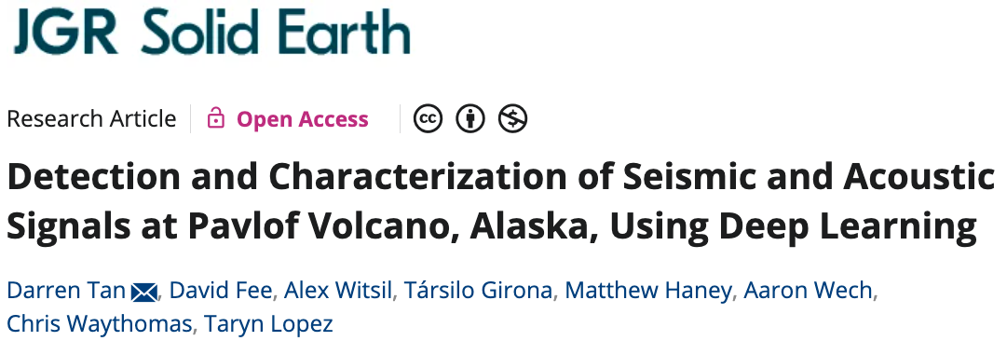
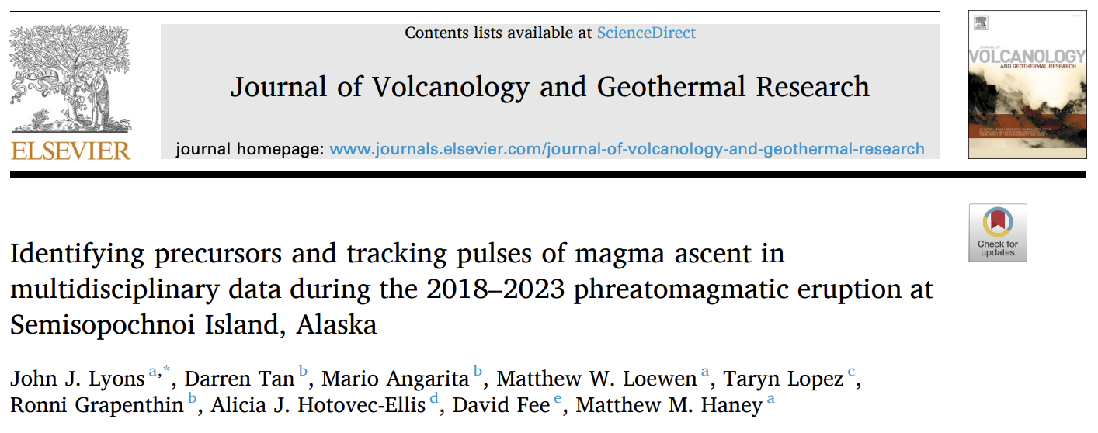

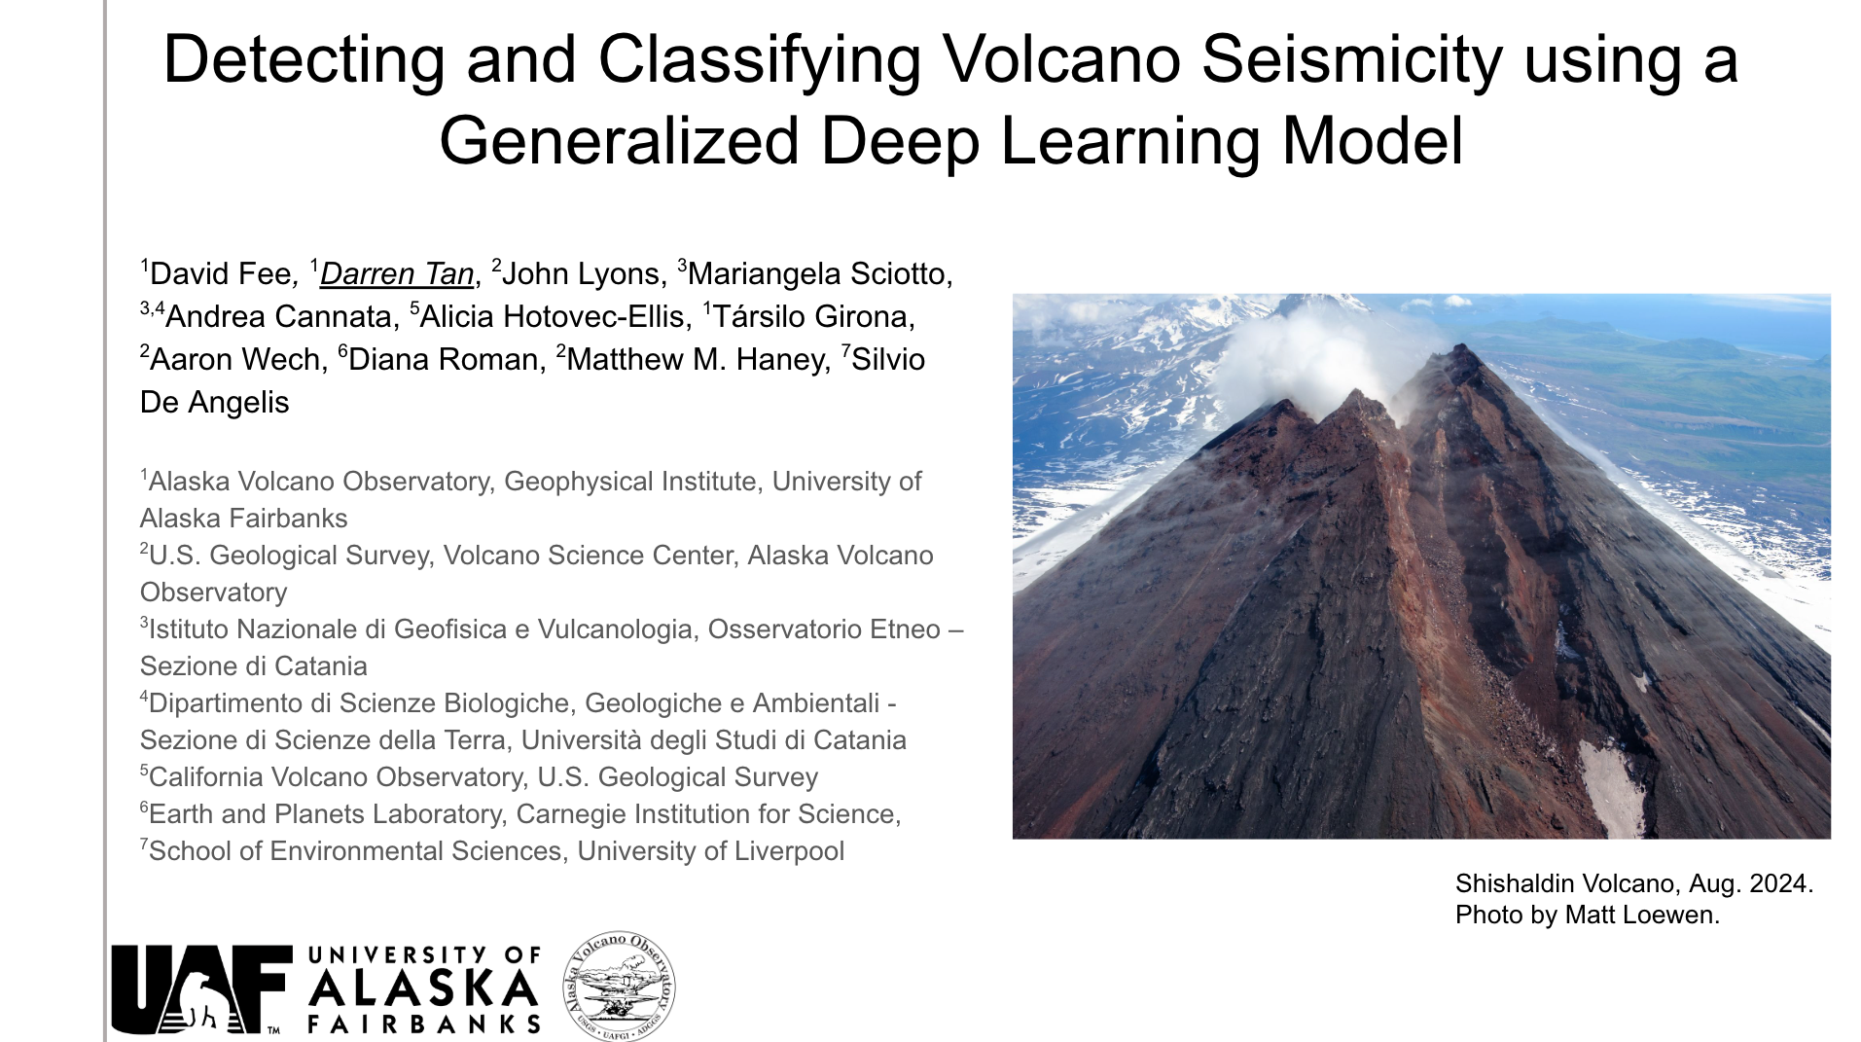
VOISS-Net:
VOlcano Infrasound & Seismic Spectrogram Neural Network
Tan et al. (2024)
Lyons et al. (2024)
Fee et al. (2025)
IAVCEI 2025
4

Slide 8
VOISS-Net:
VOlcano Infrasound & Seismic Spectrogram Neural Network
Tan et al. (2024)
Lyons et al. (2024)
David Fee,
John Lyons,
Mariangela Sciotto,
Andrea Cannata,
Alicia Hotovec-Ellis,
Társilo Girona,
Aaron Wech,
Diana Roman,
Matthew M. Haney,
Silvio De Angelis
Fee et al. (2025)
IAVCEI 2025
4

Slide 9
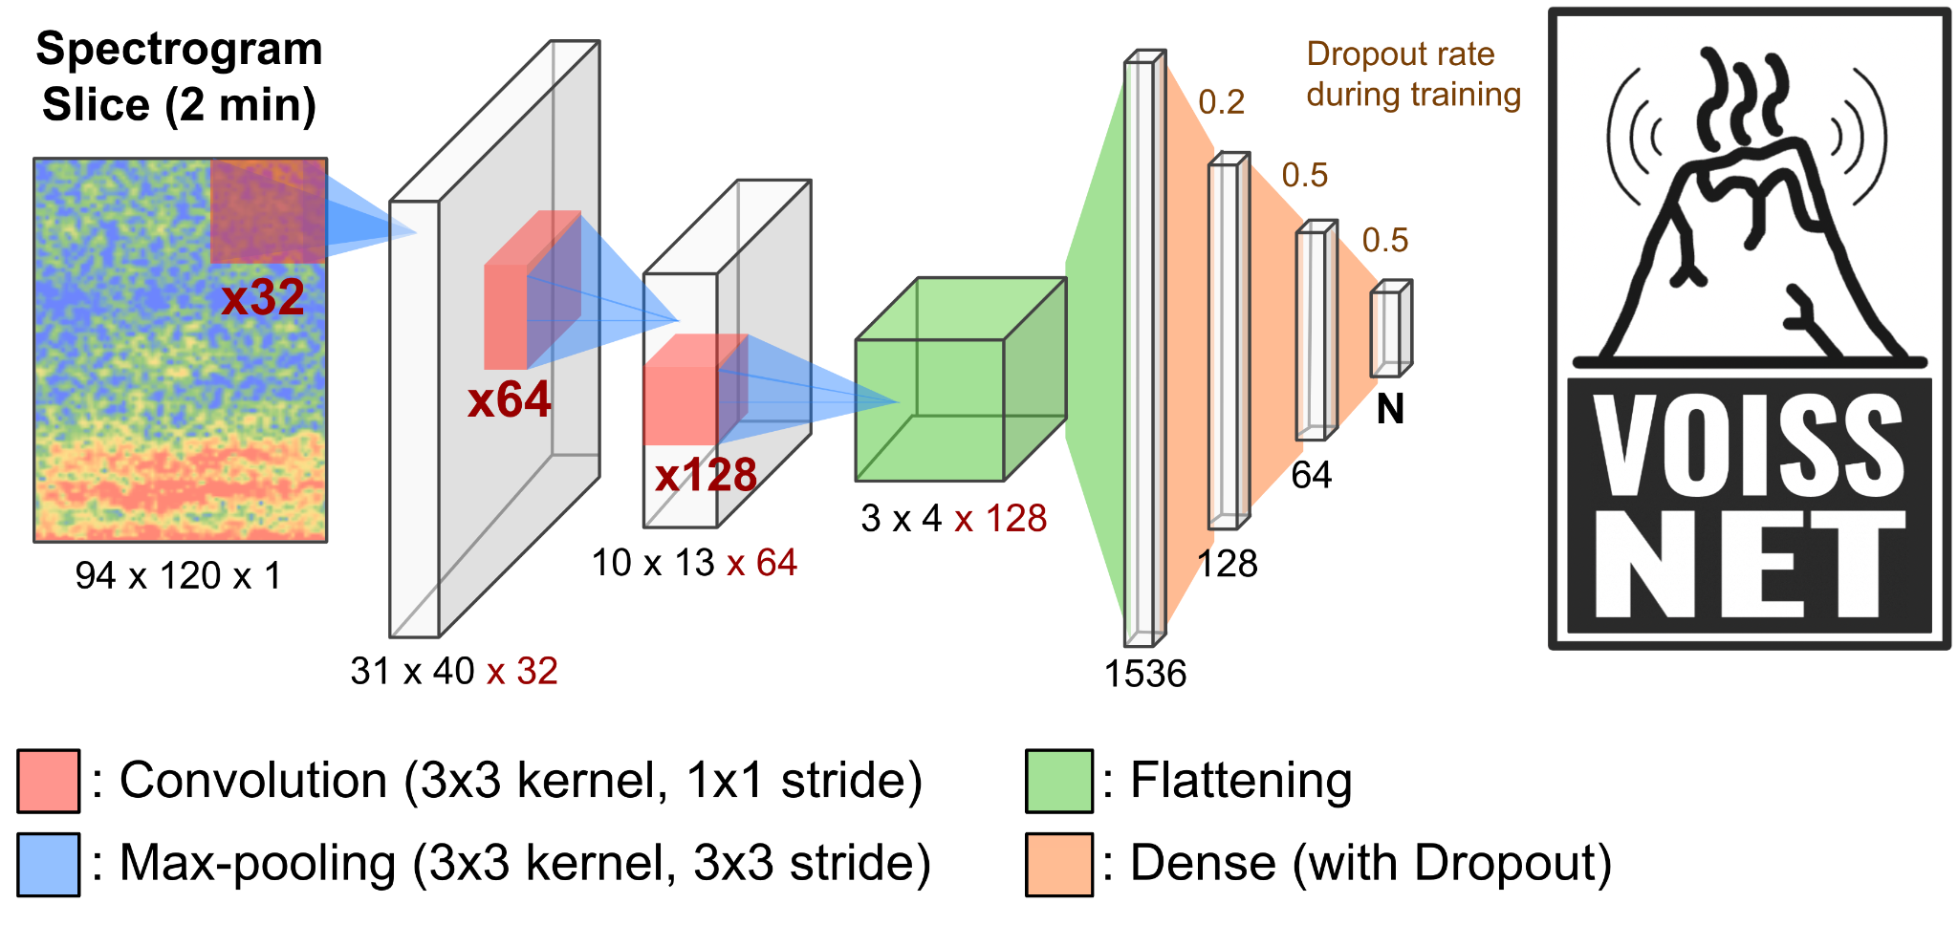
Detecting and Classifying Volcano Seismicity using a Generalized Deep Learning Model
VOISS-Net is a Convolutional Neural Network first introduced by Tan et al. (2024) to classify tremor and explosions from Pavlof Volcano, Alaska.
Fee et al. (2025) build upon the model, shrinking the spectrogram window, adding a Long Period (LP) seismic class, as well as labeled data from 7 other volcanoes.
5

Slide 10
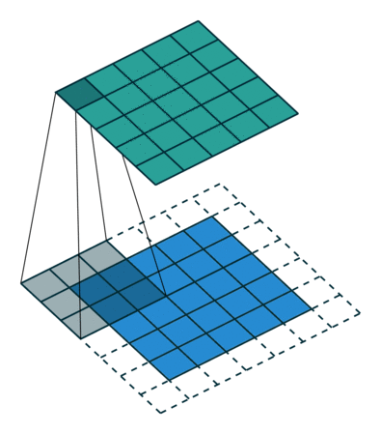
Detecting and Classifying Volcano Seismicity using a Generalized Deep Learning Model
VOISS-Net is a Convolutional Neural Network first introduced by Tan et al. (2024) to classify tremor and explosions from Pavlof Volcano, Alaska.
Fee et al. (2025) build upon the model, shrinking the spectrogram window, adding a Long Period (LP) seismic class, as well as labeled data from 7 other volcanoes.
2D Convolution Example
Blue: Input Image
Teal: Output Matrix
Grey: 3x3 Kernel/Filter
5

Slide 11
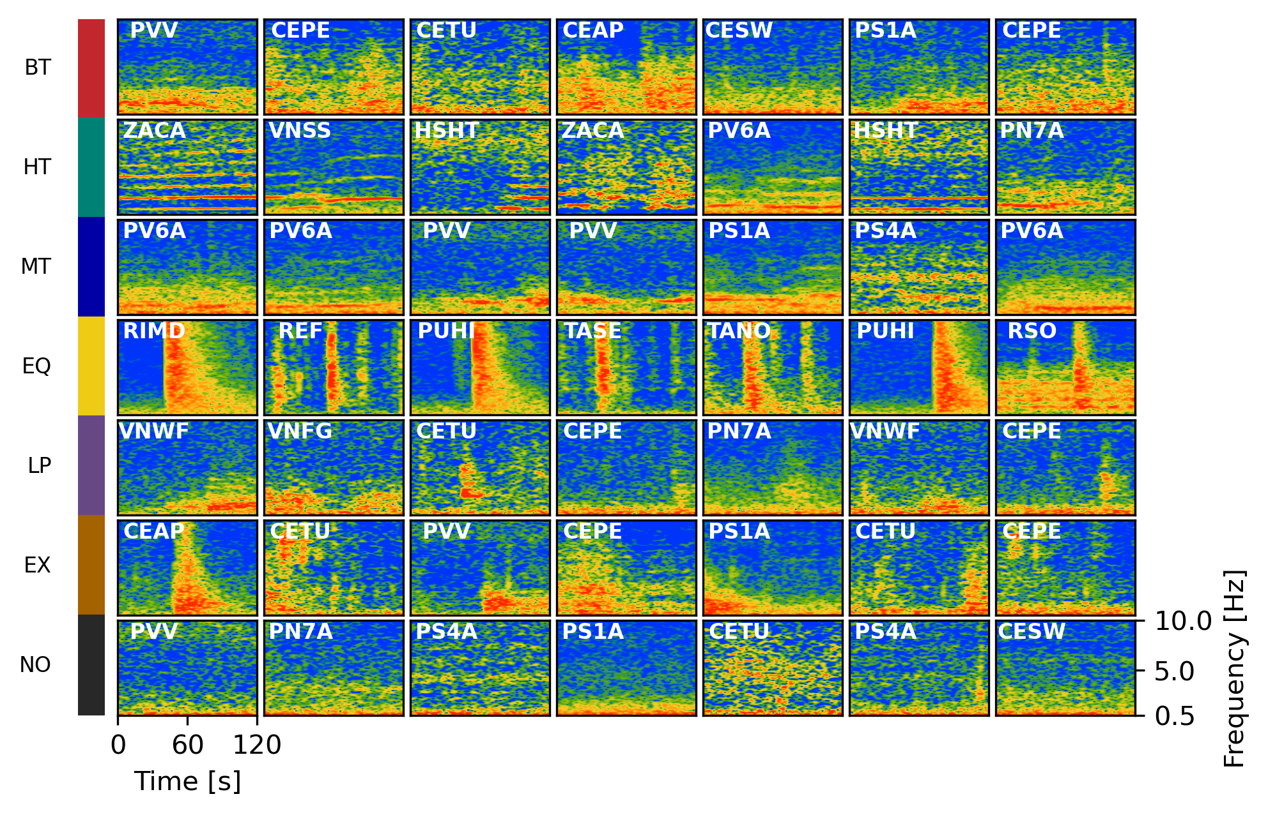
Detecting and Classifying Volcano Seismicity using a Generalized Deep Learning Model
VOISS-Net is a Convolutional Neural Network first introduced by Tan et al. (2024) to classify tremor and explosions from Pavlof Volcano, Alaska.
Fee et al. (2025) build upon the model, shrinking the spectrogram window, adding a Long Period (LP) seismic class, as well as labeled data from 7 other volcanoes.
Broadband
Tremor (BT)
Harmonic
Tremor (HT)
Monochromatic
Tremor (MT)
Earthquake
(EQ)
Long
Period (LP)
Explosion
(EX)
Noise
(NO)
5

Slide 12
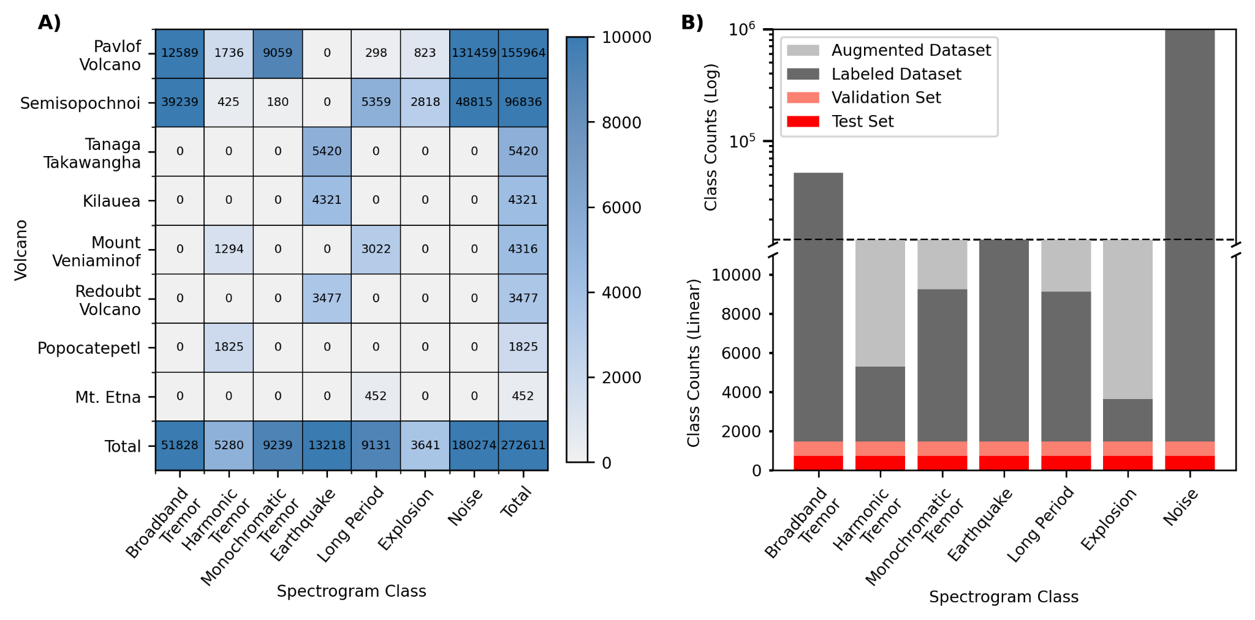
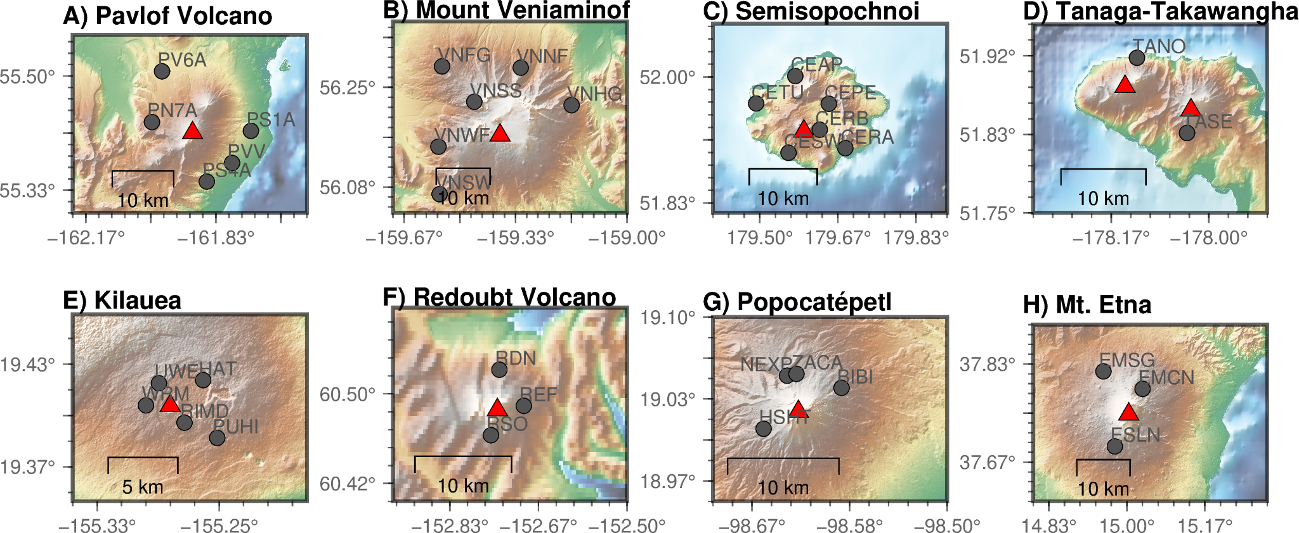
Training Dataset
Select data from eight volcanoes with range of seismic signals, source-receiver distances, and eruption styles.
Over 270,000 two-minute spectrograms.
Mixture of hand-labels (tremor, explosions, LPs) and automated catalogs (earthquakes).
Swap out regional earthquakes from Tan et al. [2024] with local VT quakes from AVO catalog.
Strong imbalance between classes so we perform augmentation on four classes to reduce bias.
6

Slide 13
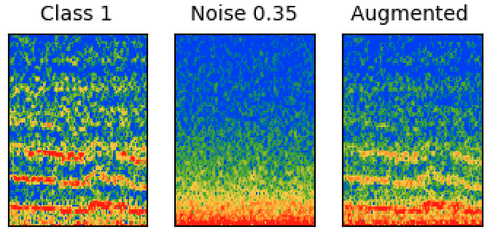
Training Dataset
Augmentation
Select data from eight volcanoes with range of seismic signals, source-receiver distances, and eruption styles.
Over 270,000 two-minute spectrograms.
Mixture of hand-labels (tremor, explosions, LPs) and automated catalogs (earthquakes).
Swap out regional earthquakes from Tan et al. [2024] with local VT quakes from AVO catalog.
Strong imbalance between classes so we perform augmentation on four classes to reduce bias.
7

Slide 14
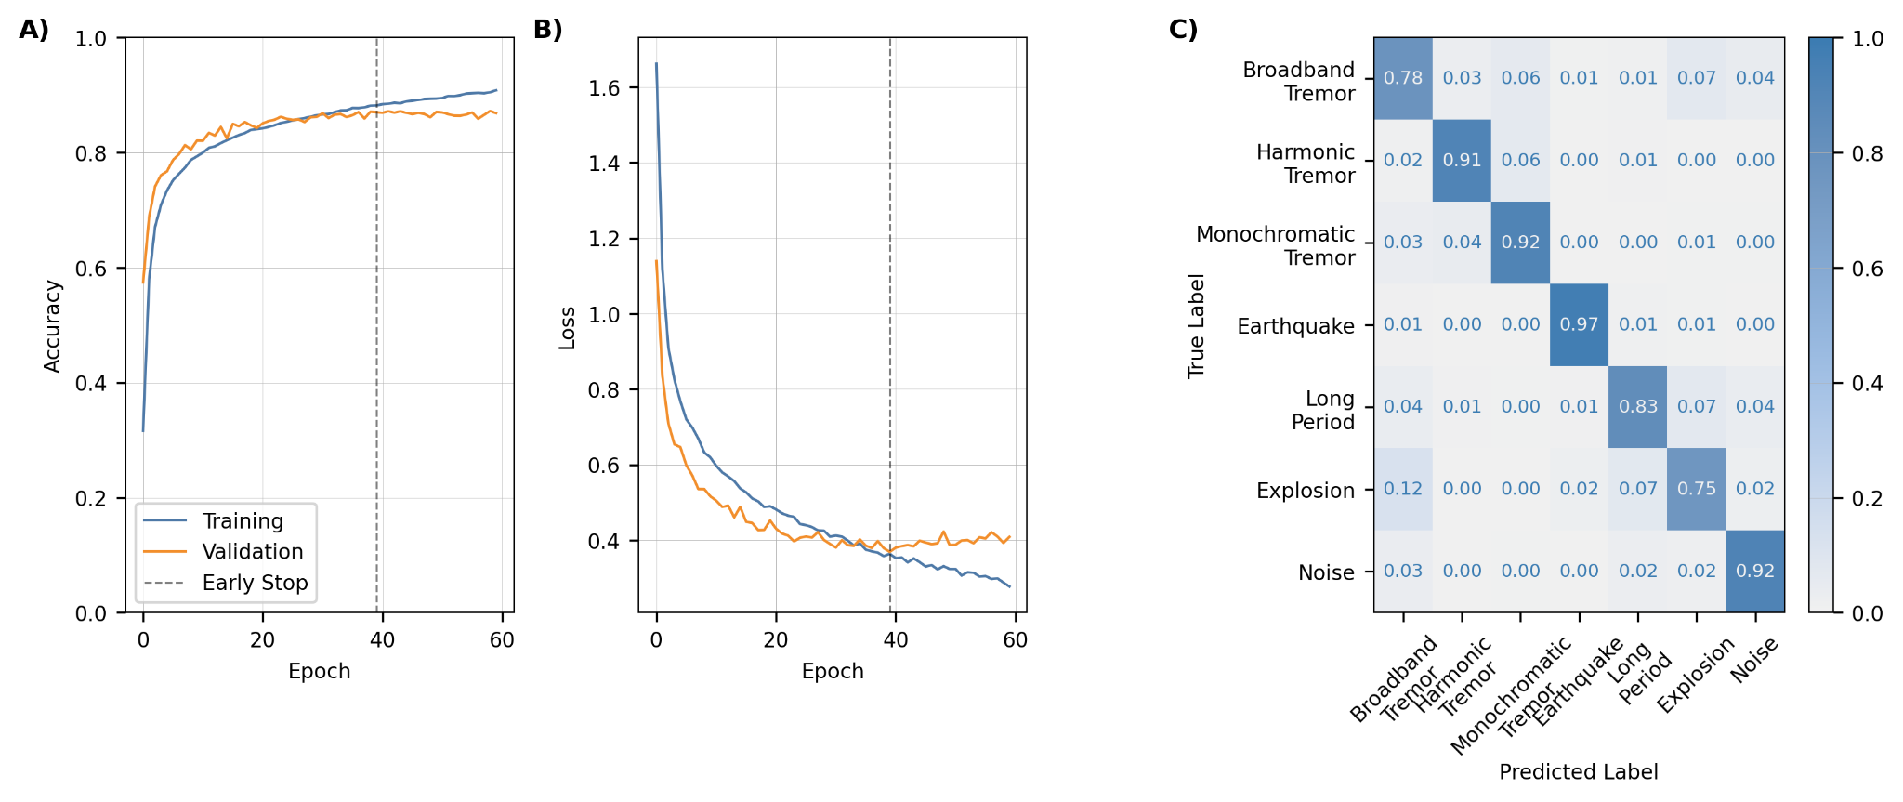
Model Training and Performance
Validation accuracy and loss curves show gradual, smooth decrease.
Other model architectures did not have a notable changes on the convergence, confusion matrix, and classifications.
8

Slide 15
Model Training and Performance
Validation accuracy and loss curves show gradual, smooth decrease.
Other model architectures did not have a notable changes on the convergence, confusion matrix, and classifications.
Overall accuracy of 87% on the test set.
Bimodal classification accuracies related to classes with similar characteristics and overlapping events.
8

Slide 16
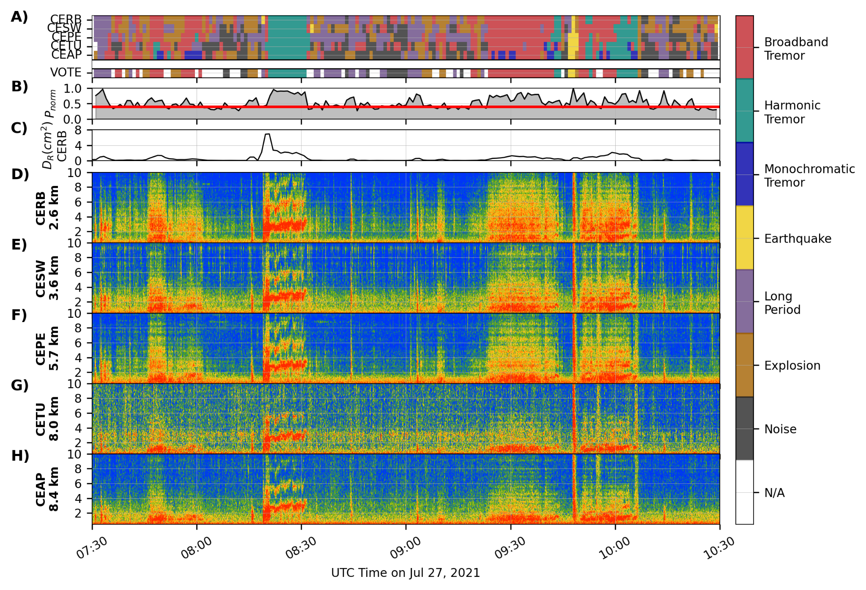
VOISS-Net Process
Semisopochnoi, Alaska: July 27, 2021
9

Slide 17
VOISS-Net Process
Semisopochnoi, Alaska: July 27, 2021
9

Slide 18
VOISS-Net Process
Semisopochnoi, Alaska: July 27, 2021
Split data into 2 min spectrogram segments with 50% overlap.
9

Slide 19
VOISS-Net Process
Semisopochnoi, Alaska: July 27, 2021
Split data into 2 min spectrogram segments with 50% overlap.
Classify each station segment into one of seven seismicity classes.
9

Slide 20
VOISS-Net Process
Semisopochnoi, Alaska: July 27, 2021
Split data into 2 min spectrogram segments with 50% overlap.
Classify each station segment into one of seven seismicity classes.
Combine class predictions into a “network vote” and associated probability.
9

Slide 21
VOISS-Net Process
Semisopochnoi, Alaska: July 27, 2021
Split data into 2 min spectrogram segments with 50% overlap.
Classify each station segment into one of seven seismicity classes.
Combine class predictions into a “network vote” and associated probability.
9

Slide 22
VOISS-Net Process
Semisopochnoi, Alaska: July 27, 2021
Split data into 2 min spectrogram segments with 50% overlap.
Classify each station segment into one of seven seismicity classes.
Combine class predictions into a “network vote” and associated probability.
Computed Reduced Displacement (D_{R}) to provide amplitude estimate.
9

Slide 23
VOISS-Net Process
Semisopochnoi, Alaska: July 27, 2021
Split data into 2 min spectrogram segments with 50% overlap.
Classify each station segment into one of seven seismicity classes.
Combine class predictions into a “network vote” and associated probability.
Computed Reduced Displacement (D_{R}) to provide amplitude estimate.
Spectrograms show a range of spectral signatures and classifications that are consistent with our interpretation.
9

Slide 24
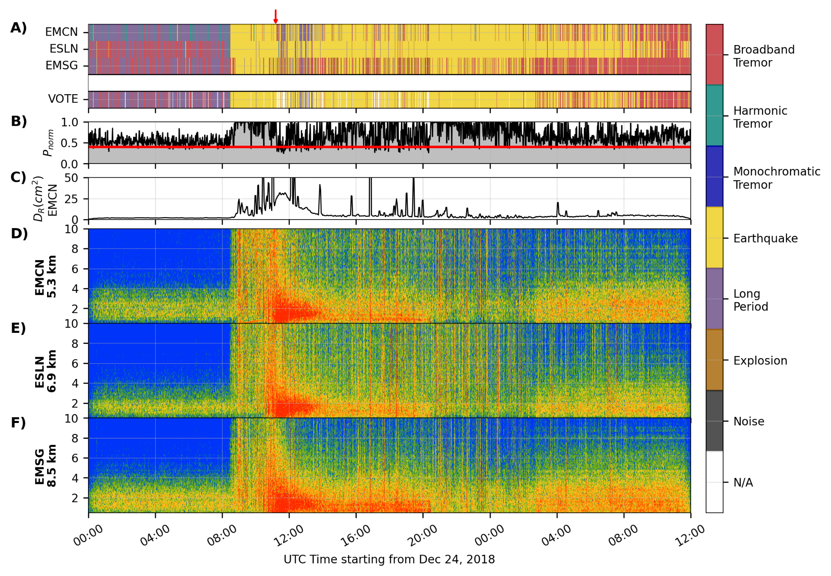
VOISS-Net Examples: Mt. Etna, Italy (December 24, 2018)
Onset
Energetic fissure eruption and dike intrusion.
36 hrs of data from 3 stations.
LPs/tremor prior to eruption.
Dike intrusion onset characterized by Earthquake classifications.
Eruption onset and duration marked by mix of overlapping Earthquake and Broadband Tremor classifications.
Overall consistent with our and published interpretations.
10

Slide 25
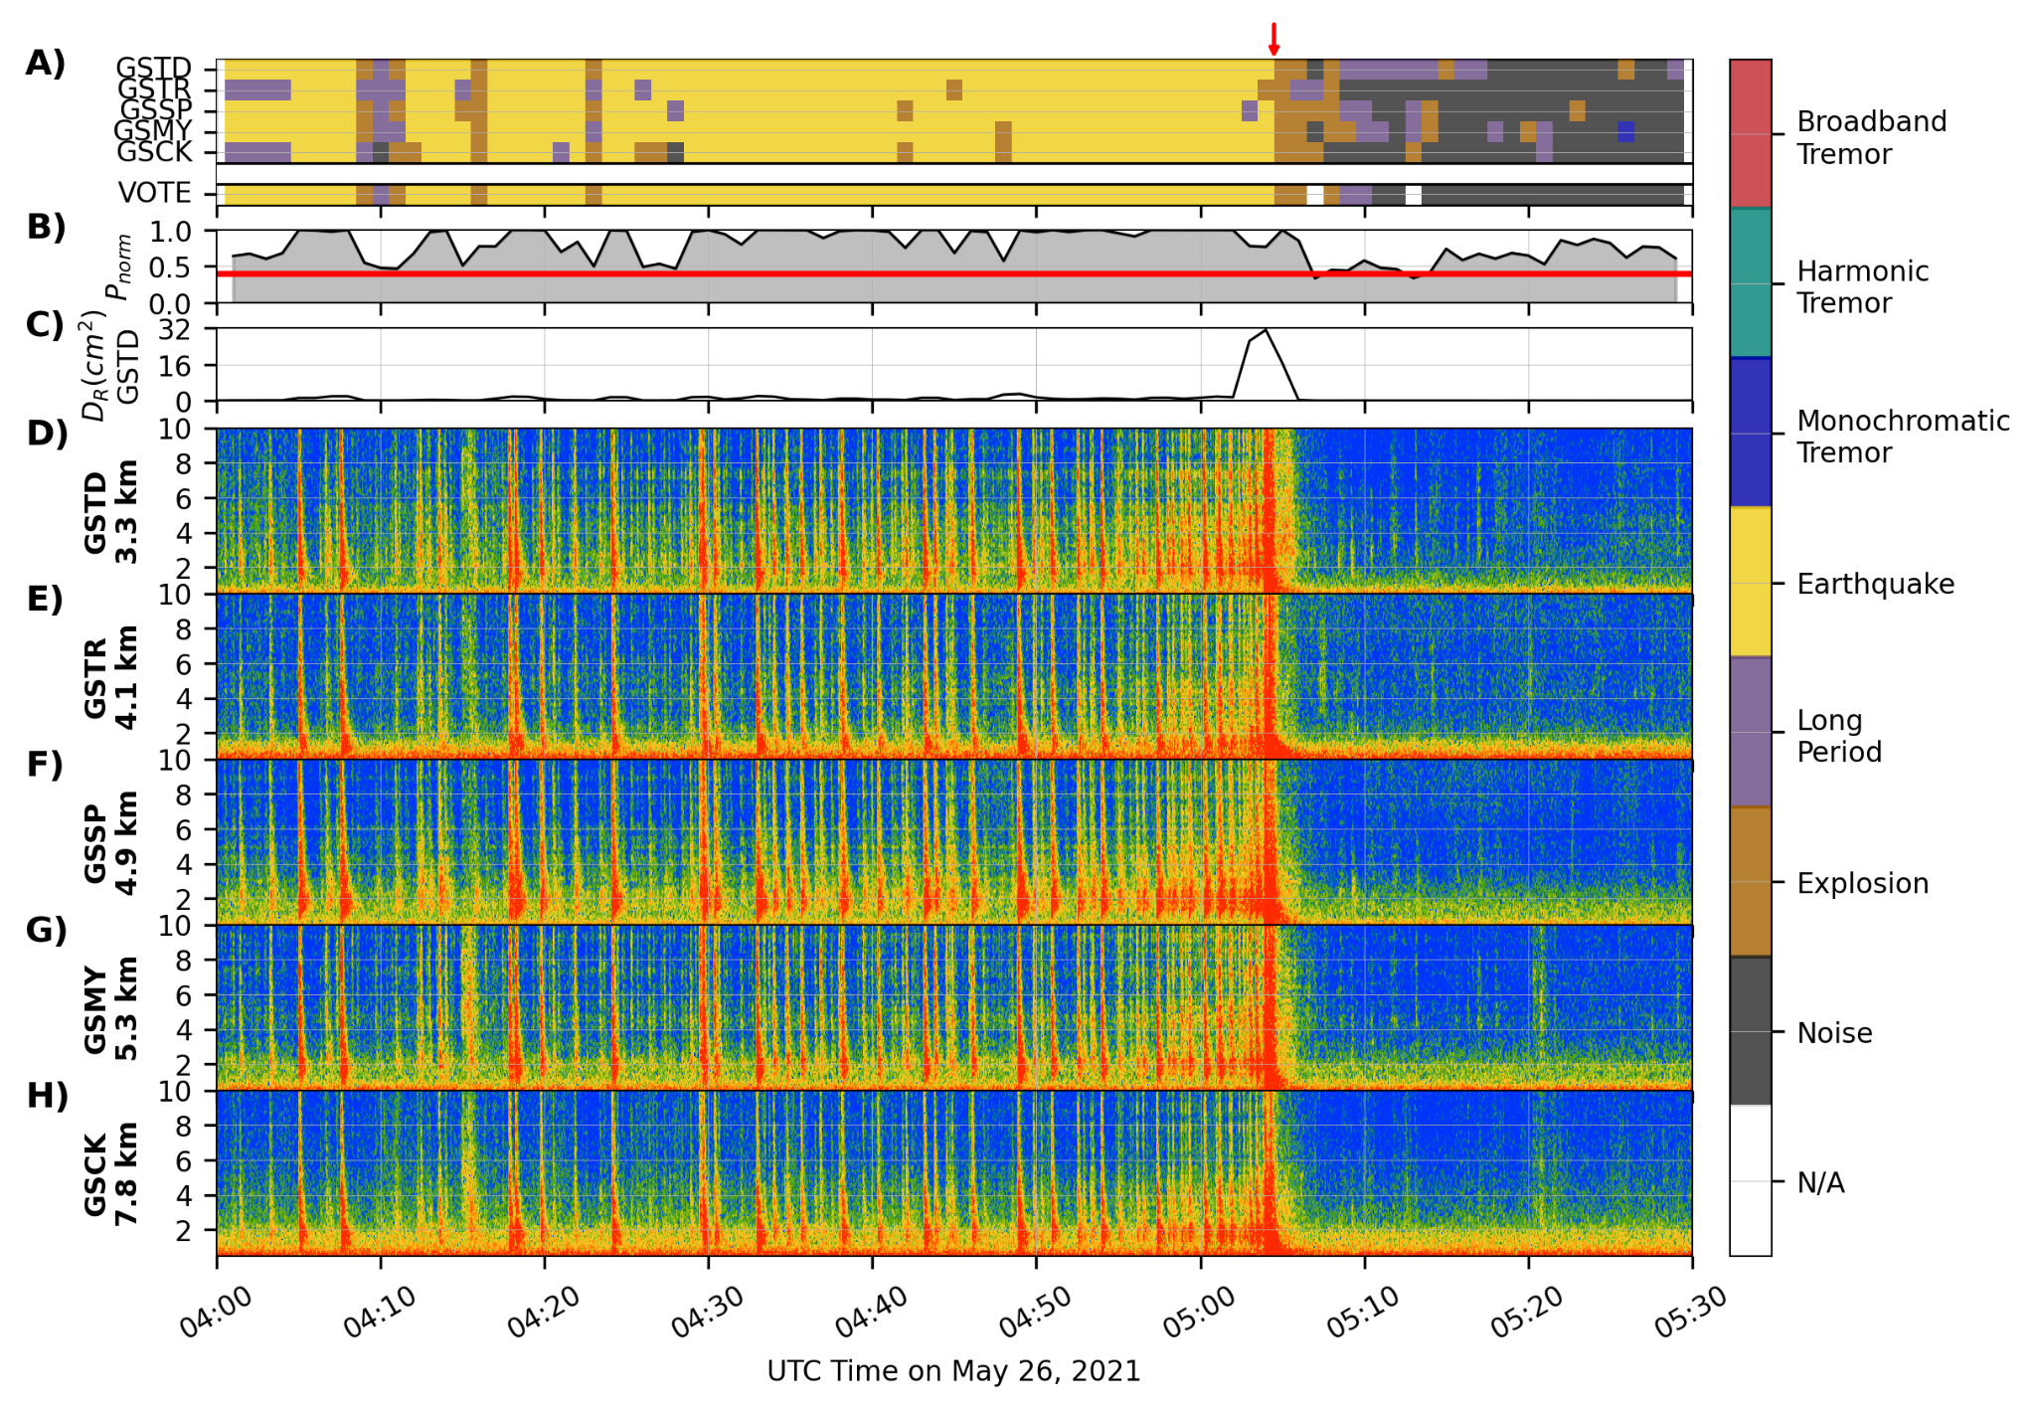
VOISS-Net Examples: Great Sitkin, Alaska (May 26, 2021)
Eruption
Explosive eruption at 05:03 UTC preceded by earthquakes.
1.5 hrs from 5 stations.
VOISS-Net classifies the precursory seismicity as Earthquakes, but Power and Roman [2024] classified them as LPs based on weak S-waves and low Frequency Index.
Generally detects and classifies the precursory seismicity, explosion, and return to background.
11

Slide 26
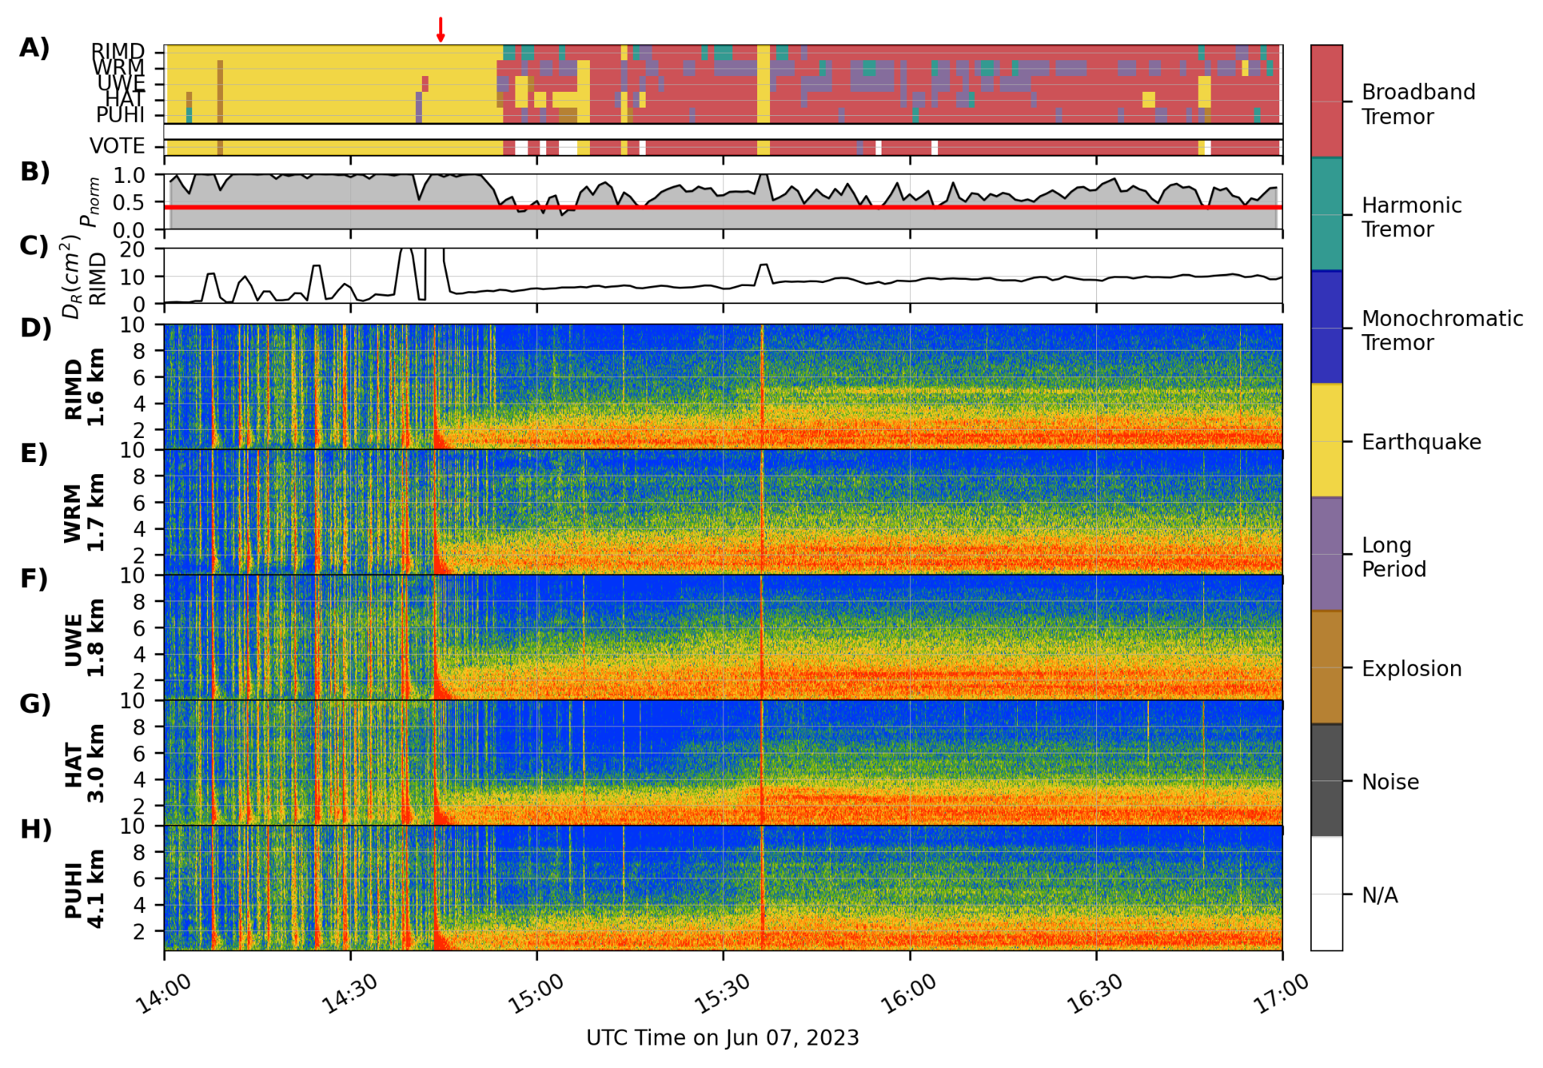
VOISS-Net Examples: Kilauea, Hawaii (June 7, 2023)
Onset
Pre-eruptive VT swarm followed by tremor and lava fountaining.
3 hrs of data from 5 stations.
VOISS-Net detects pre-eruptive VTs and eventually tremor.
Mix of tremor types with Broadband Tremor dominant.
Overall performs well, but the eruption onset is not apparent as a change in classification due to overlapping tremor and VTs.
12

Slide 27
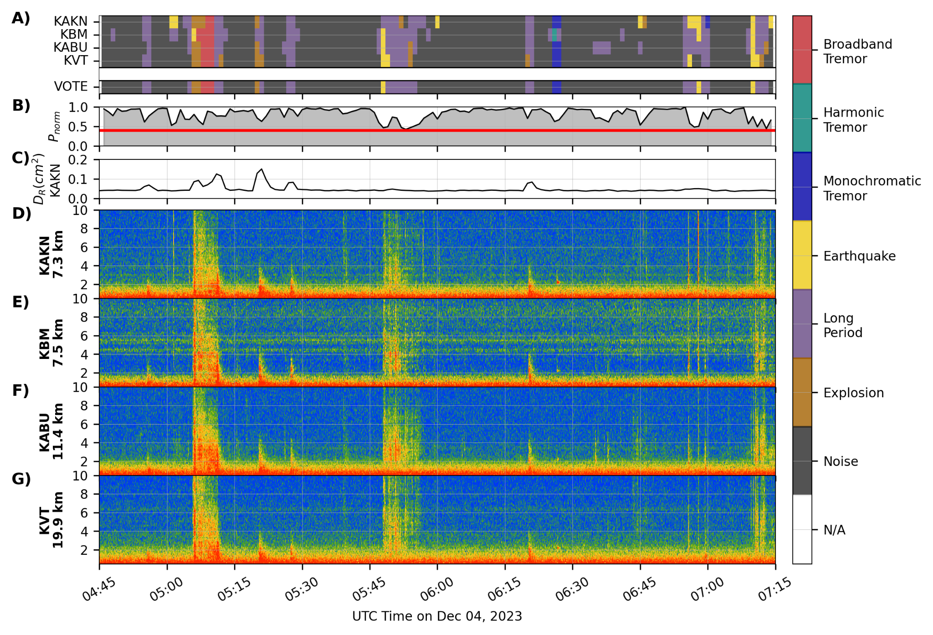
VOISS-Net Examples: Trident, Alaska (December 4, 2023)
Non-eruptive earthquake swarm with shallow VTs and deep mixed frequency events.
2.5 hrs on 4 stations.
VOISS-Net classifies background as Noise, multiple classes for mixed frequency events, and a tornillo as Monochromatic Tremor.
Multiple teleseismic events are misclassified as LPs.
13

Slide 28
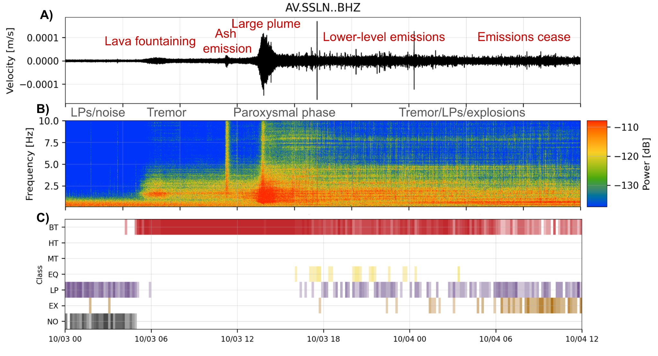
VOISS-Net Examples: Shishaldin, Alaska (2023 Paroxysm 12)
Explosive eruption with clear run-up and decline.
VOISS-Net applied to 3 stations.
05:05 UTC: VOISS-Net detects Broadband Tremor.
13:40: Significant plume, coincident with rapid seismic increase and change in spectra.
~17:30: Emissions continuing but at a lower level. Broadband Tremor, Earthquakes, LPs, and Explosions detected. Seismicity remains elevated.
>18:30: Emissions cease. Repeating LP events become more frequent. Seismicity remains elevated. A few VT earthquakes.
Provides clear record of pre-, syn-, and post-eruptive seismicity.
14

Slide 29
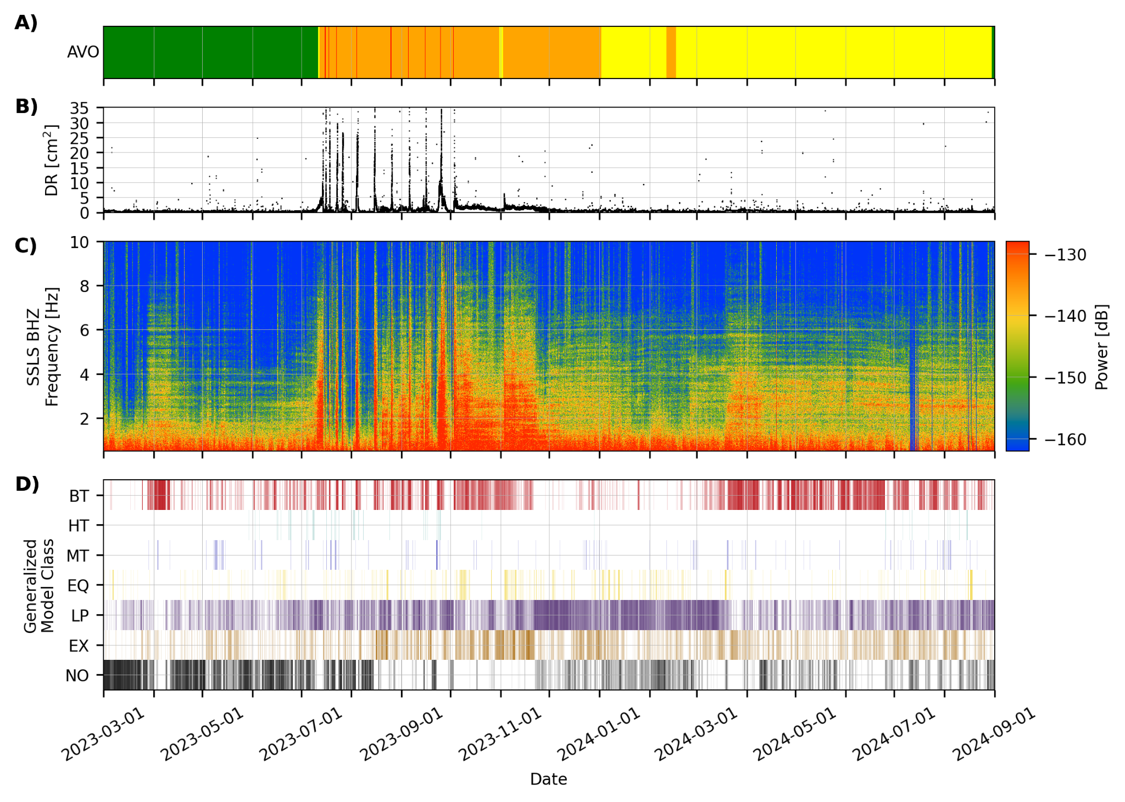
VOISS-Net Examples: Shishaldin, Alaska (2023-2024)
Precursory broadband tremor in March, May, June 2023.
July-Nov paroxysms clearly visible in change from LPs/Explosions to energetic Broadband Tremor.
Sparse VT earthquakes, harmonic tremor, and monochromatic tremor.
Very gradual decrease in tremor and switch to more LPs/explosions in 2024.
Provides long-term catalog for consistent seismicity characterization.
15

Slide 30
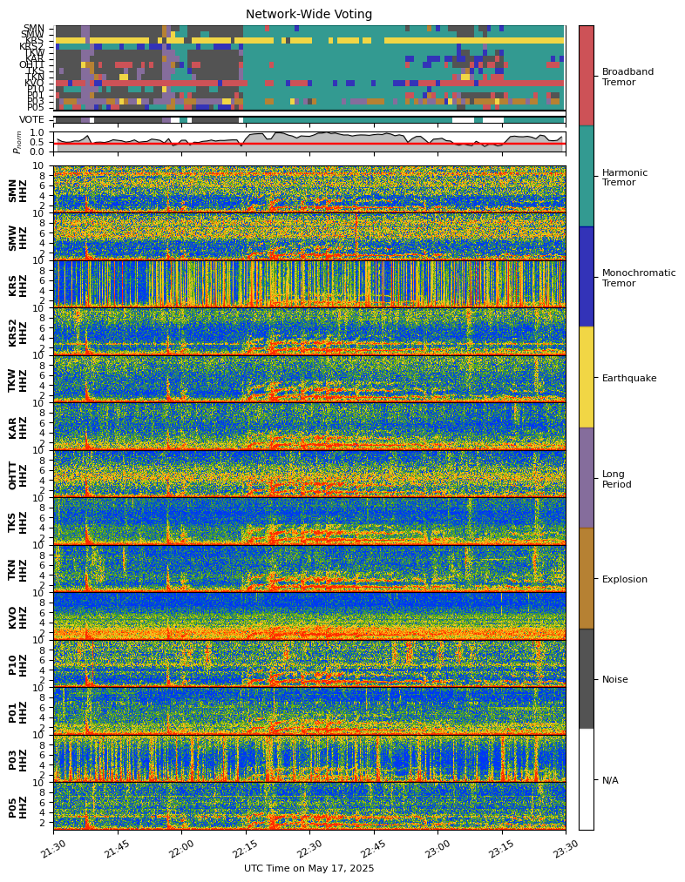
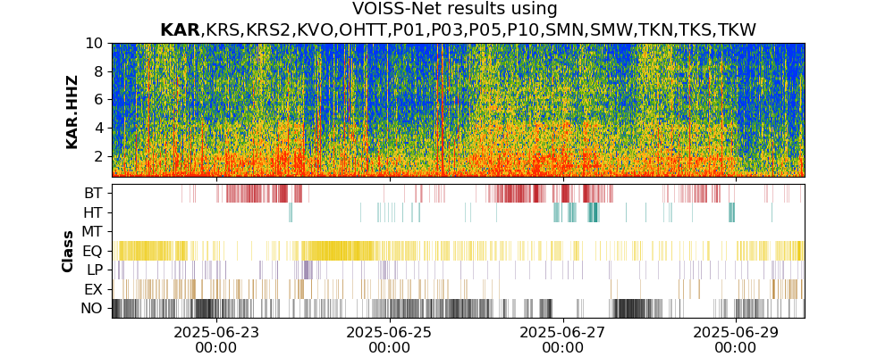
VOISS-Net Examples: Shinmoedake
16

Slide 31
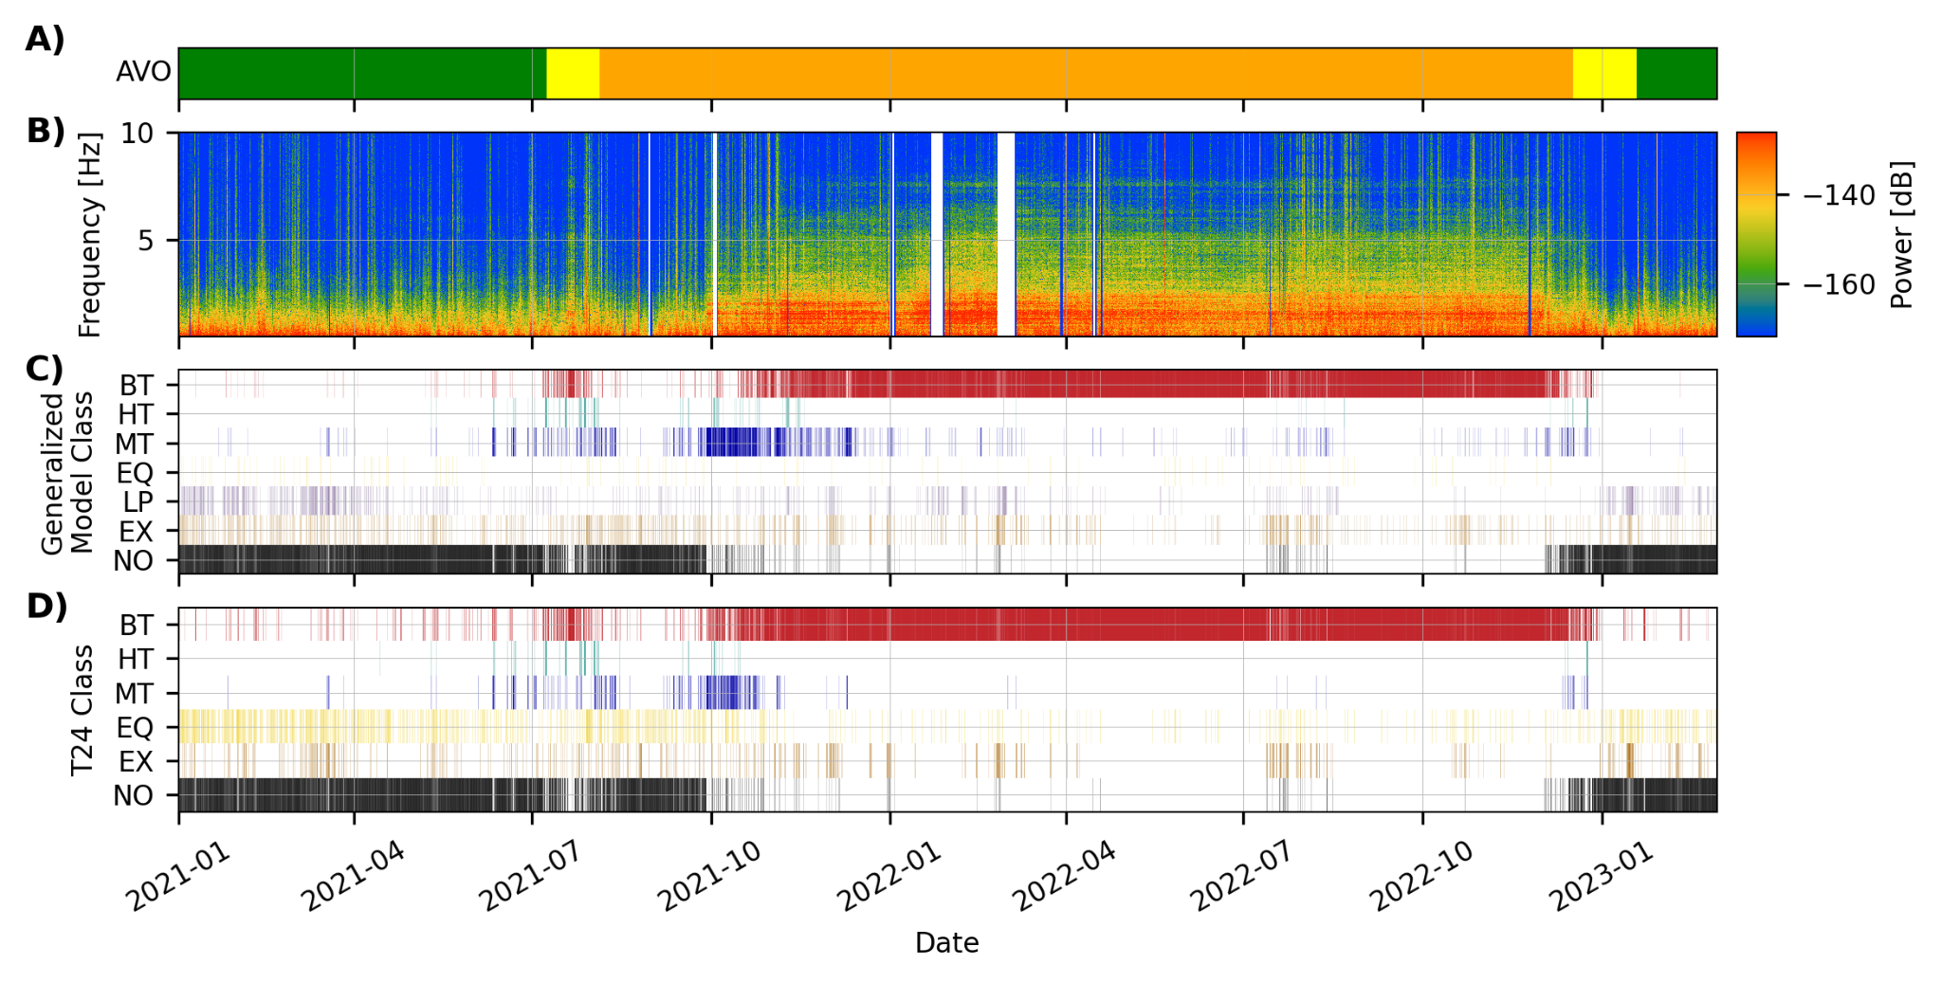
VOISS-Net Examples: Pavlof 2021–22 Eruption (V1 vs V2 comparison)
16

Slide 32
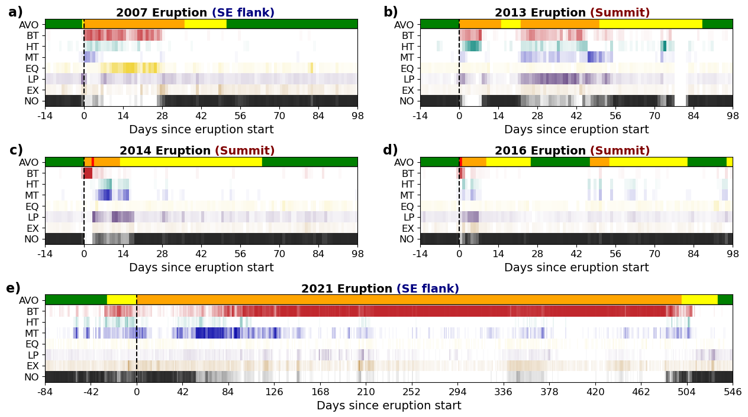
VOISS-Net Examples: Pavlof Multiple Eruptions (‘07, ‘13, ‘14, ‘16, ‘21)
17

Slide 33
VOISS-Net Examples: Pavlof Multiple Eruptions (‘07, ‘13, ‘14, ‘16, ‘21)
`
monochromatic to broadband tremor transition
17

Slide 34
VOISS-Net Examples: Pavlof Multiple Eruptions (‘07, ‘13, ‘14, ‘16, ‘21)
17

Slide 35
VOISS-Net Examples: Pavlof Multiple Eruptions (‘07, ‘13, ‘14, ‘16, ‘21)
tremor diversity & resurgent activity
more LPs and less explosions
17

Slide 36
VOISS-Net Examples: Pavlof Multiple Eruptions (‘07, ‘13, ‘14, ‘16, ‘21)
17

Slide 37
Automated tremor detection from VOISS-Net? A realistic conclusion
VOISS-Net offers a fast and interpretable way to characterize volcanic seismicity through its spectral features, making it valuable for both research and monitoring purposes.
Model occasionally struggles with overlapping events and transients, and performs poorly on signals it has not been trained on.
Model uses a station-first approach. Although it can be applied on any number of stations, the “vote” falters when too many stations are noisy, unlike coherence-based methods (e.g., COVSEISNET).
18

Slide 38
Automated tremor detection from VOISS-Net? A realistic conclusion
VOISS-Net offers a fast and interpretable way to characterize volcanic seismicity through its spectral features, making it valuable for both research and monitoring purposes.
Model occasionally struggles with overlapping events and transients, and performs poorly on signals it has not been trained on.
Model uses a station-first approach. Although it can be applied on any number of stations, the “vote” falters when too many stations are noisy, unlike coherence-based methods (e.g., COVSEISNET).
Common criticisms:
“I’d rather just look at a spectrogram” → spectrograms are primarily useful in short timescales and are memory intensive to save. VOISS-Net presents years-long seismicity at a glance.
18

Slide 39
Automated tremor detection from VOISS-Net? A realistic conclusion
VOISS-Net offers a fast and interpretable way to characterize volcanic seismicity through its spectral features, making it valuable for both research and monitoring purposes.
Model occasionally struggles with overlapping events and transients, and performs poorly on signals it has not been trained on.
Model uses a station-first approach. Although it can be applied on any number of stations, the “vote” falters when too many stations are noisy, unlike coherence-based methods (e.g., COVSEISNET).
Common criticisms:
“I’d rather just look at a spectrogram” → spectrograms are primarily useful in short timescales and are memory intensive to save. VOISS-Net presents years-long seismicity at a glance.
“Why don’t you have a lahar class” → VOISS-Net augments an analyst’s read on spectral characteristics; prominent volcanic processes can differ from volcano to volcano, and it is difficult to create a balanced labeled dataset spanning a large range of class types.
18

Slide 40
Automated tremor detection from VOISS-Net? A realistic conclusion
VOISS-Net offers a fast and interpretable way to characterize volcanic seismicity through its spectral features, making it valuable for both research and monitoring purposes.
Model occasionally struggles with overlapping events and transients, and performs poorly on signals it has not been trained on.
Model uses a station-first approach. Although it can be applied on any number of stations, the “vote” falters when too many stations are noisy, unlike coherence-based methods (e.g., COVSEISNET).
Common criticisms:
“I’d rather just look at a spectrogram” → spectrograms are primarily useful in short timescales and are memory intensive to save. VOISS-Net presents years-long seismicity at a glance.
“Why don’t you have a lahar class” → VOISS-Net augments an analyst’s read on spectral characteristics; prominent volcanic processes can differ from volcano to volcano, and it is difficult to create a balanced labeled dataset spanning a large range of class types.
“It doesn’t work well for my volcano” → VOISS-Net is a framework / ML application philosophy, and we encourage users to label and train models for their own needs!
18

Slide 41
OK… I’ve detected all this tremor… now what?
19

Slide 42
OK… I’ve detected all this tremor… now what?
we catalog them, to facilitate monitoring and research!
19

Slide 43

OK… I’ve detected all this tremor… now what?
we catalog them, to facilitate monitoring and research!
(yes i’m someone who has a cat)
19

Slide 44
TREMCAT: An ObsPy framework to catalog tremor
For decades, we have had a (somewhat) standardized way to catalog transient volcanic seismicity, with a (somewhat) standardized way to store and distribute that information (think QuakeML files, ObsPy’s Catalog)
A similar framework does not exist for tremor, due to difficulties in constraining locations, start times, detection/location methods, and the 101 nuances about them.
But that does not mean we should not try!
20

Slide 45
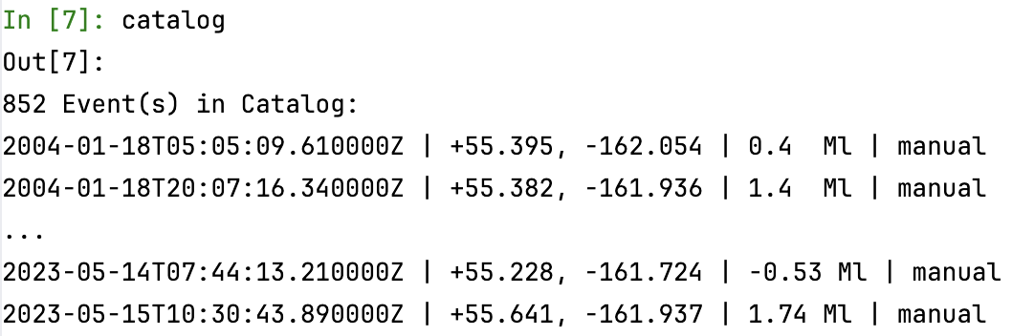
TREMCAT: An ObsPy framework to catalog tremor
For decades, we have had a (somewhat) standardized way to catalog transient volcanic seismicity, with a (somewhat) standardized way to store and distribute that information (think QuakeML files, ObsPy’s Catalog)
A similar framework does not exist for tremor, due to difficulties in constraining locations, start times, detection/location methods, and the 101 nuances about them.
But that does not mean we should not try!
ObsPy’s Catalog
20

Slide 46
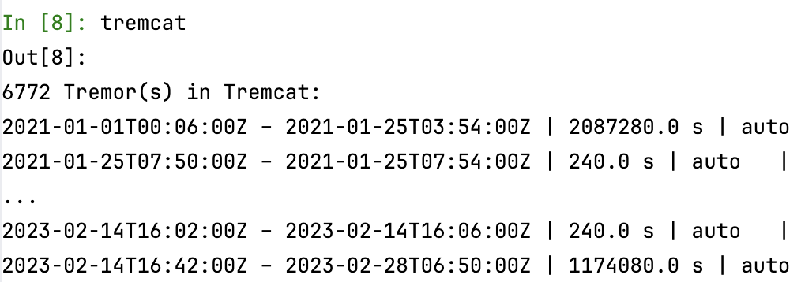
TREMCAT: An ObsPy framework to catalog tremor
For decades, we have had a (somewhat) standardized way to catalog transient volcanic seismicity, with a (somewhat) standardized way to store and distribute that information (think QuakeML files, ObsPy’s Catalog)
A similar framework does not exist for tremor, due to difficulties in constraining locations, start times, detection/location methods, and the 101 nuances about them.
But that does not mean we should not try!
ObsPy’s Catalog
TREMCAT’s Catalog
20

Slide 47
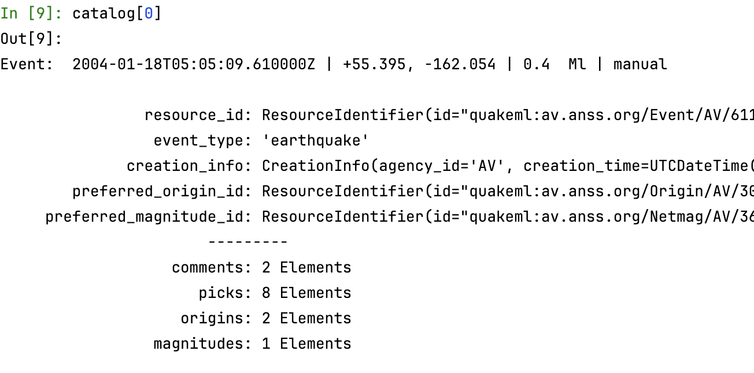
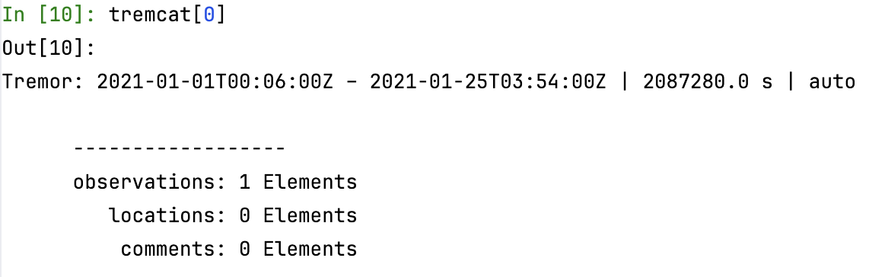
TREMCAT: An ObsPy framework to catalog tremor
For decades, we have had a (somewhat) standardized way to catalog transient volcanic seismicity, with a (somewhat) standardized way to store and distribute that information (think QuakeML files, ObsPy’s Catalog)
A similar framework does not exist for tremor, due to difficulties in constraining locations, start times, detection/location methods, and the 101 nuances about them.
But that does not mean we should not try!
ObsPy’s Catalog
TREMCAT’s Catalog
21

Slide 48
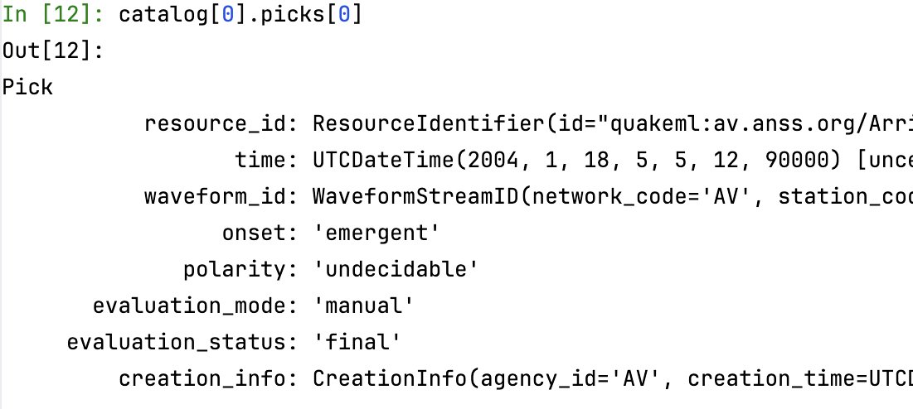
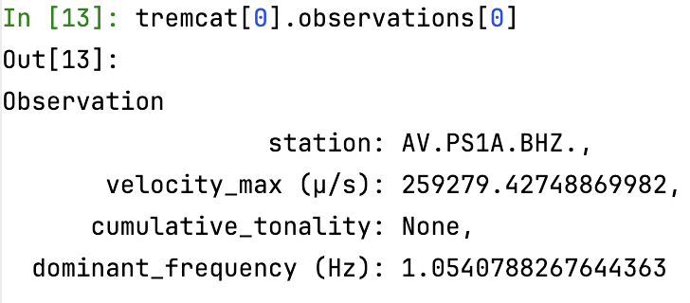
TREMCAT: An ObsPy framework to catalog tremor
For decades, we have had a (somewhat) standardized way to catalog transient volcanic seismicity, with a (somewhat) standardized way to store and distribute that information (think QuakeML files, ObsPy’s Catalog)
A similar framework does not exist for tremor, due to difficulties in constraining locations, start times, detection/location methods, and the 101 nuances about them.
But that does not mean we should not try!
ObsPy’s Catalog
TREMCAT’s Catalog
22

Slide 49
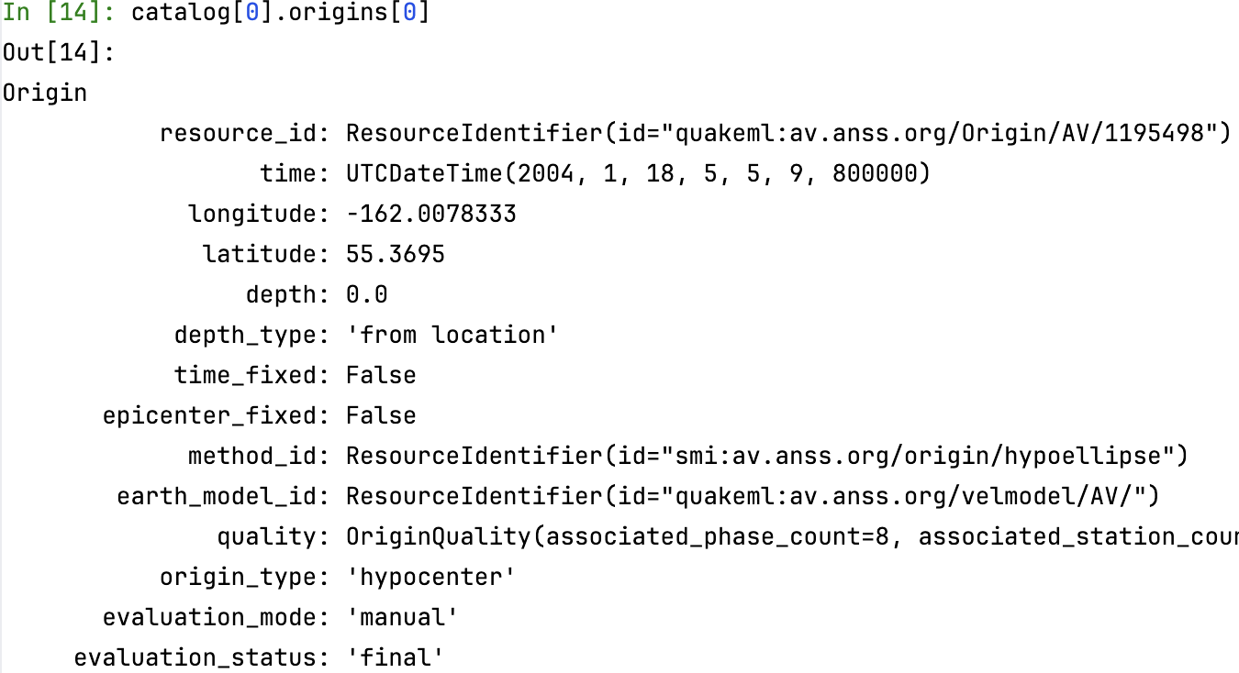
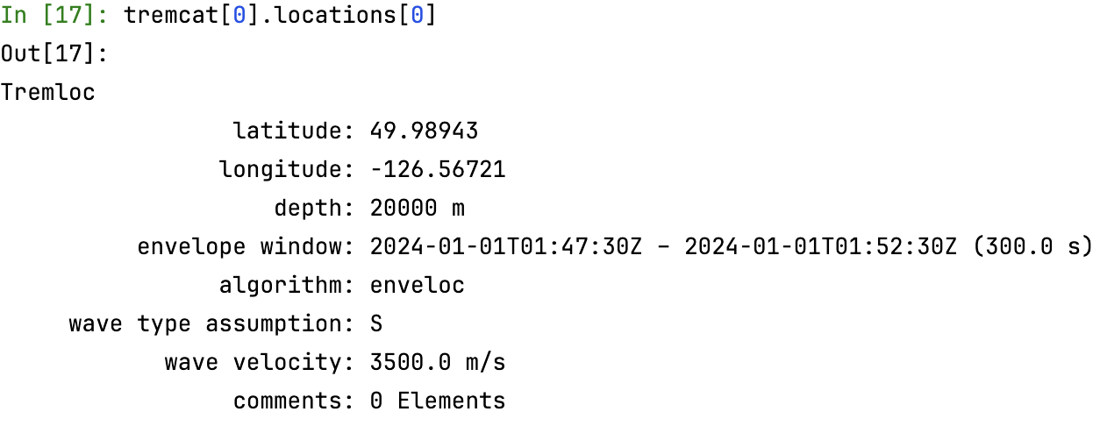
TREMCAT: An ObsPy framework to catalog tremor
ObsPy’s Catalog
TREMCAT’s Catalog
23

Slide 50
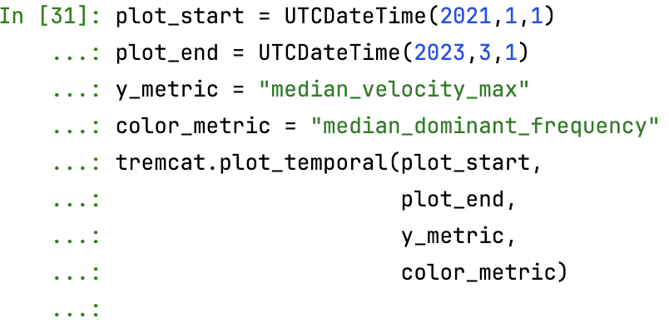
TREMCAT: An ObsPy framework to catalog tremor
TREMCAT’s “attribute” plotting function
24

Slide 51
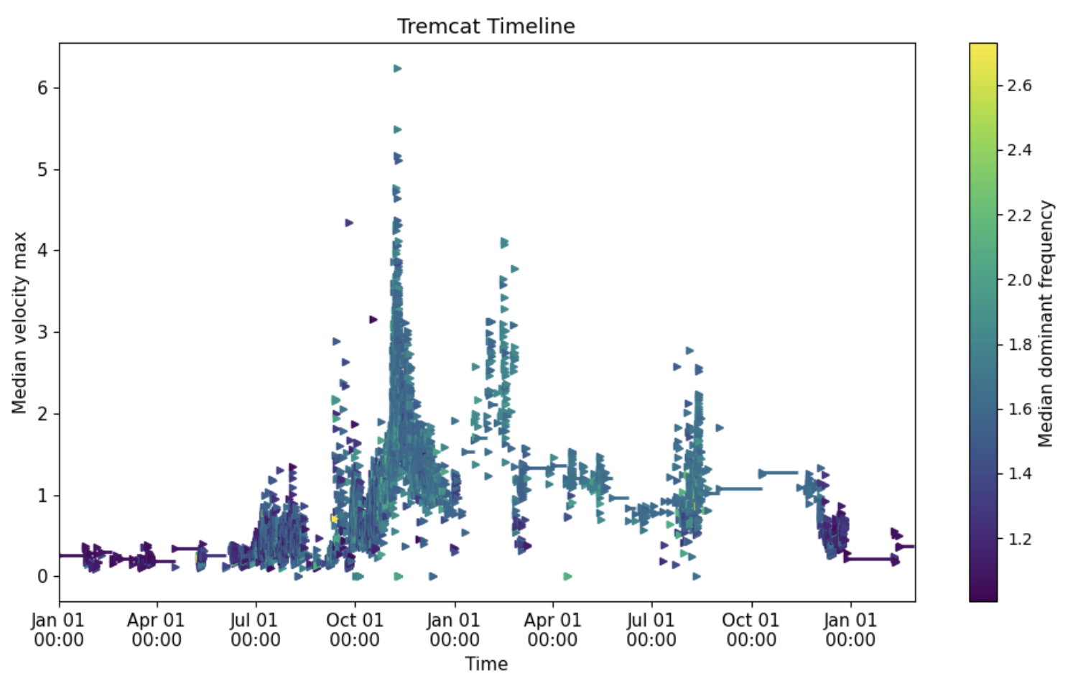
TREMCAT: An ObsPy framework to catalog tremor
TREMCAT’s “attribute” plotting function
24

Slide 52
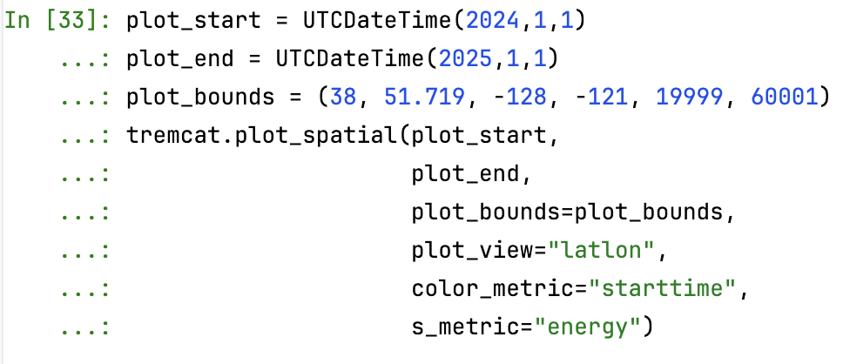
TREMCAT: An ObsPy framework to catalog tremor
TREMCAT’s “location” plotting function
25

Slide 53
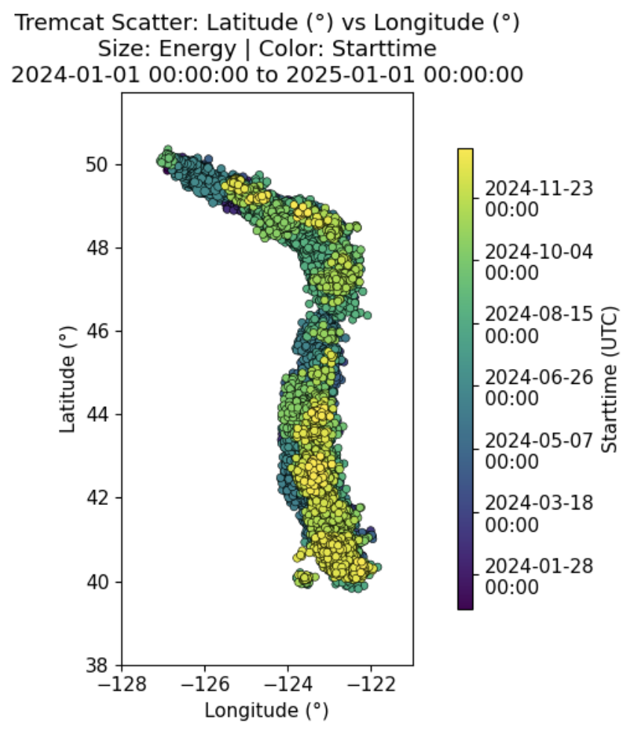
TREMCAT: An ObsPy framework to catalog tremor
TREMCAT’s “location” plotting function
25

Slide 54
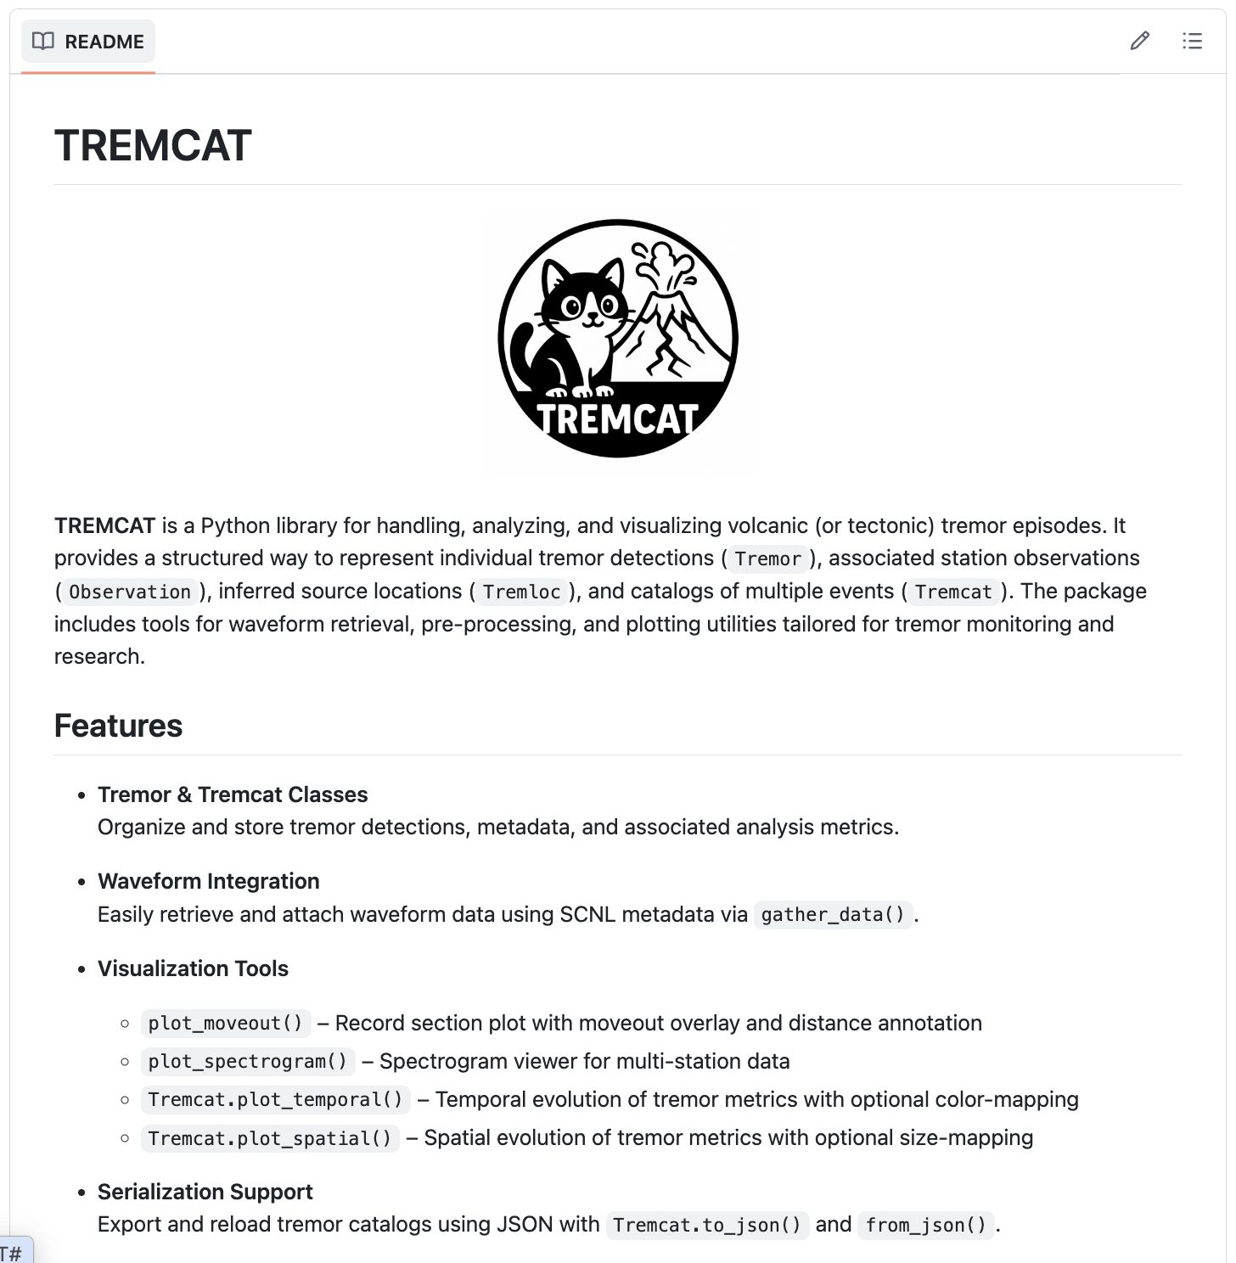
A kind request for feedback:
How do you archive tremor instances at your observatory? Would you use this?
What utilities are missing?
What attributes should be mandatory?
Do you have a dataset that you would like to try it on?
Do you want to be a co-developer?
→ darren.tanpk@ntu.edu.sg
Thank you!
26

